Slide 1
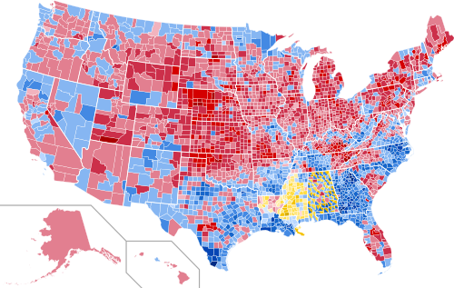
1960

Slide 2
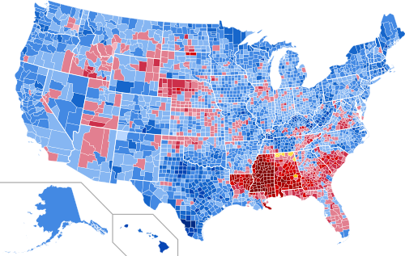
1964

Slide 3
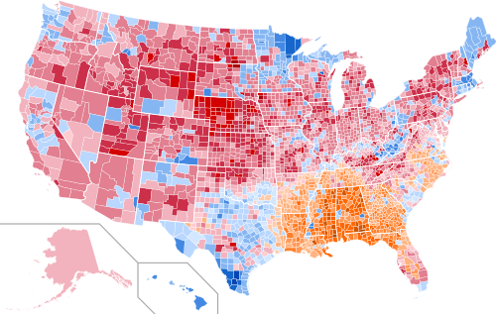
1968

Slide 4
Nixon

Slide 5
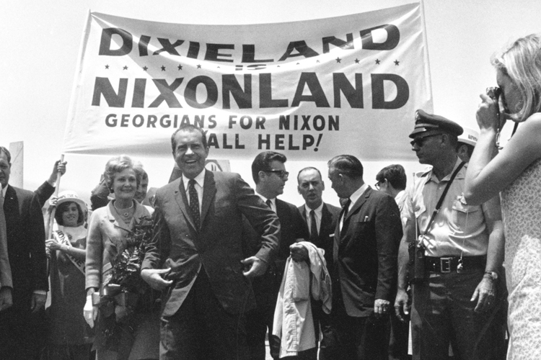
Politics
Southern Strategy
Win old southern Dem support
Slow integration and busing
Put a southerner on the Supreme Court

Slide 6
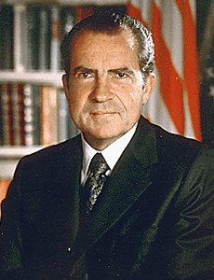
Downsizing
Nixon was backlash to liberalism
Goal was to downsize federal government
“New Federalism
More emphasis on state/local control
“Law and Order”
https://www.youtube.com/watch?v=cEdtwQ8OguY

Slide 7
Economy
Stagflation
High inflation and unemployment
OPEC (Organization of Petroleum Exporting Countries)
Oil cartel of Middle Eastern countries
Controlled prices aka don’t make them mad

Slide 8
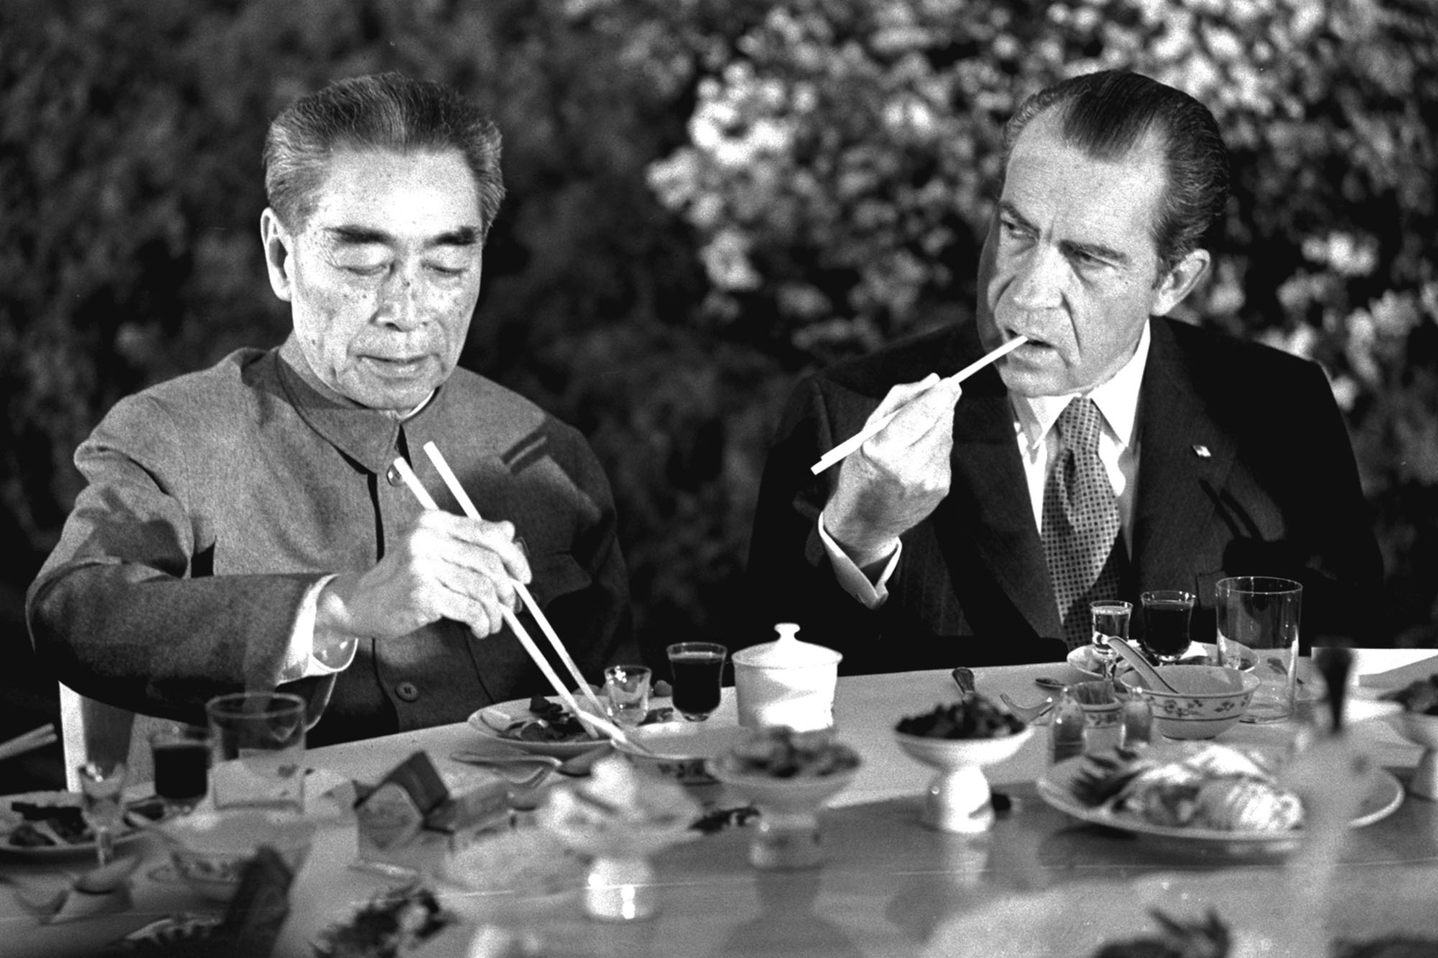
Foreign Policy
Realpolitik(Kissinger)
Think only of power and the circumstances, not morals or lofty principles
Détente
Ease Cold War tensions; visit Communist country
Visits China
Moscow
SALT (Strategic arms Limitation Talks)
Limit missiles and nuclear weapons

Slide 9
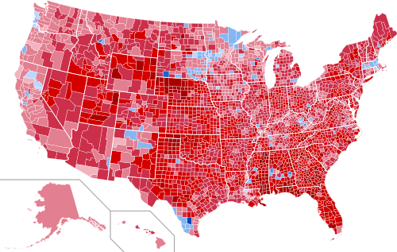
1972

Slide 10
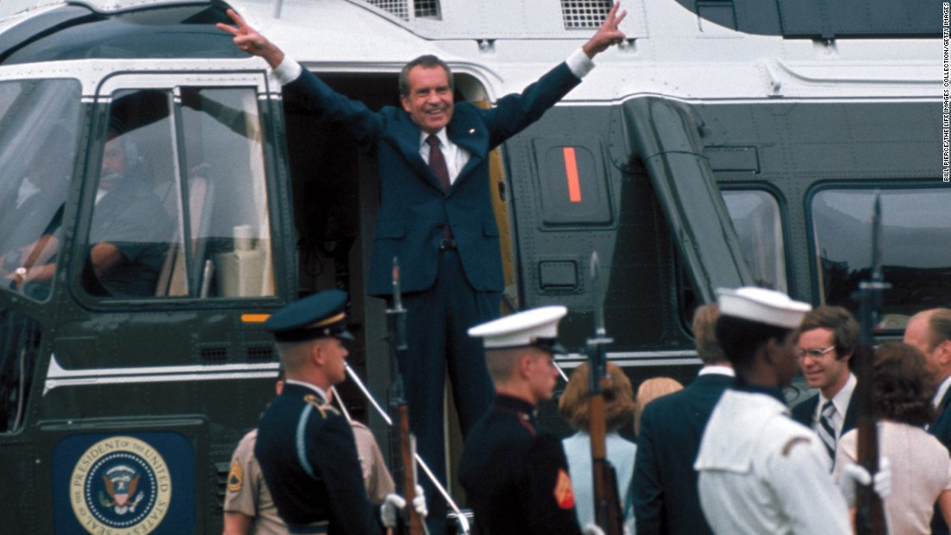
Watergate
https://www.youtube.com/watch?v=IHnmriyXYeg
“I shall resign the presidency effective at noon tomorrow.”

